Slide 1
Indian Fintech Ecosystem
AI-Enabled Digital Payments Transforming India's Financial Landscape
Presenter: Gurivi Reddy Yasaswini
[Page 1] | Pioneering the future of AI-driven digital payments in India.

Slide 2
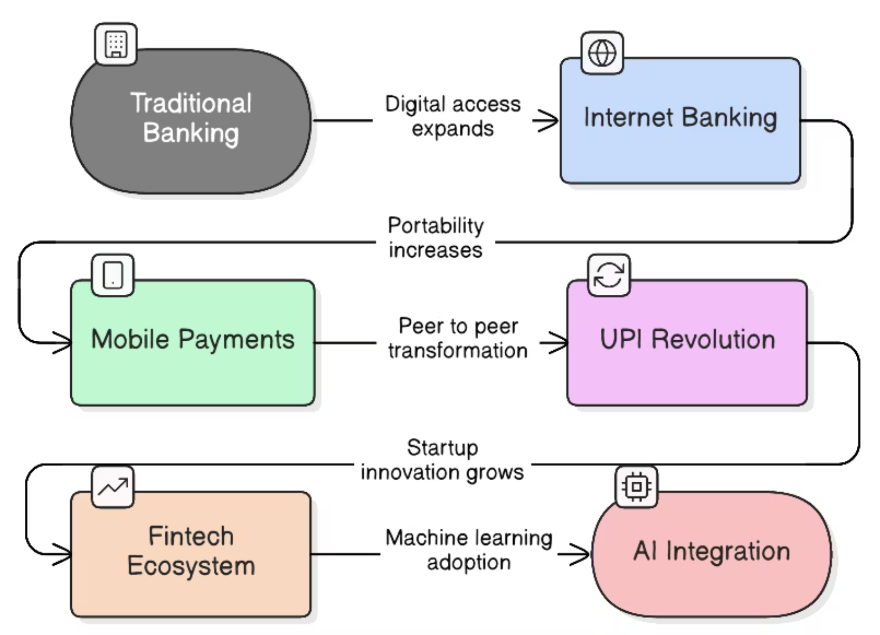
Evolution of Fintech in India
Traditional banking to digital payments
Mobile-first user adoption
AI-powered financial services
Regulatory-led innovation
[Page 2] | Tracking the journey from legacy banking to AI-driven financial innovation.

Slide 3
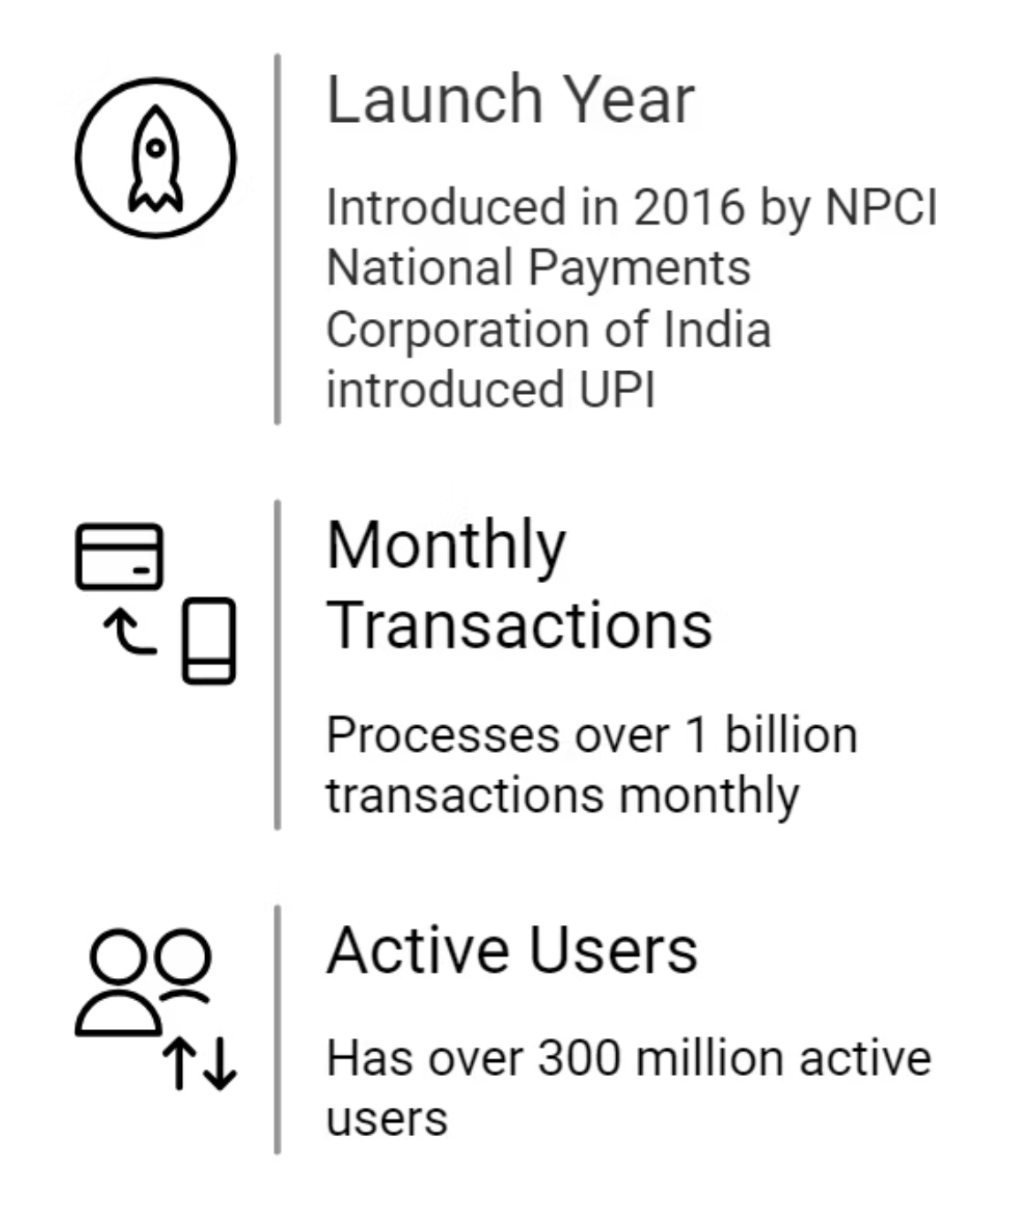
UPI Revolution
2016–Present
Instant bank-to-bank transfers
QR code-based payments
No card details required
AI-powered fraud monitoring
[Page 3] | Transforming India into a global leader in digital payments.

Slide 4
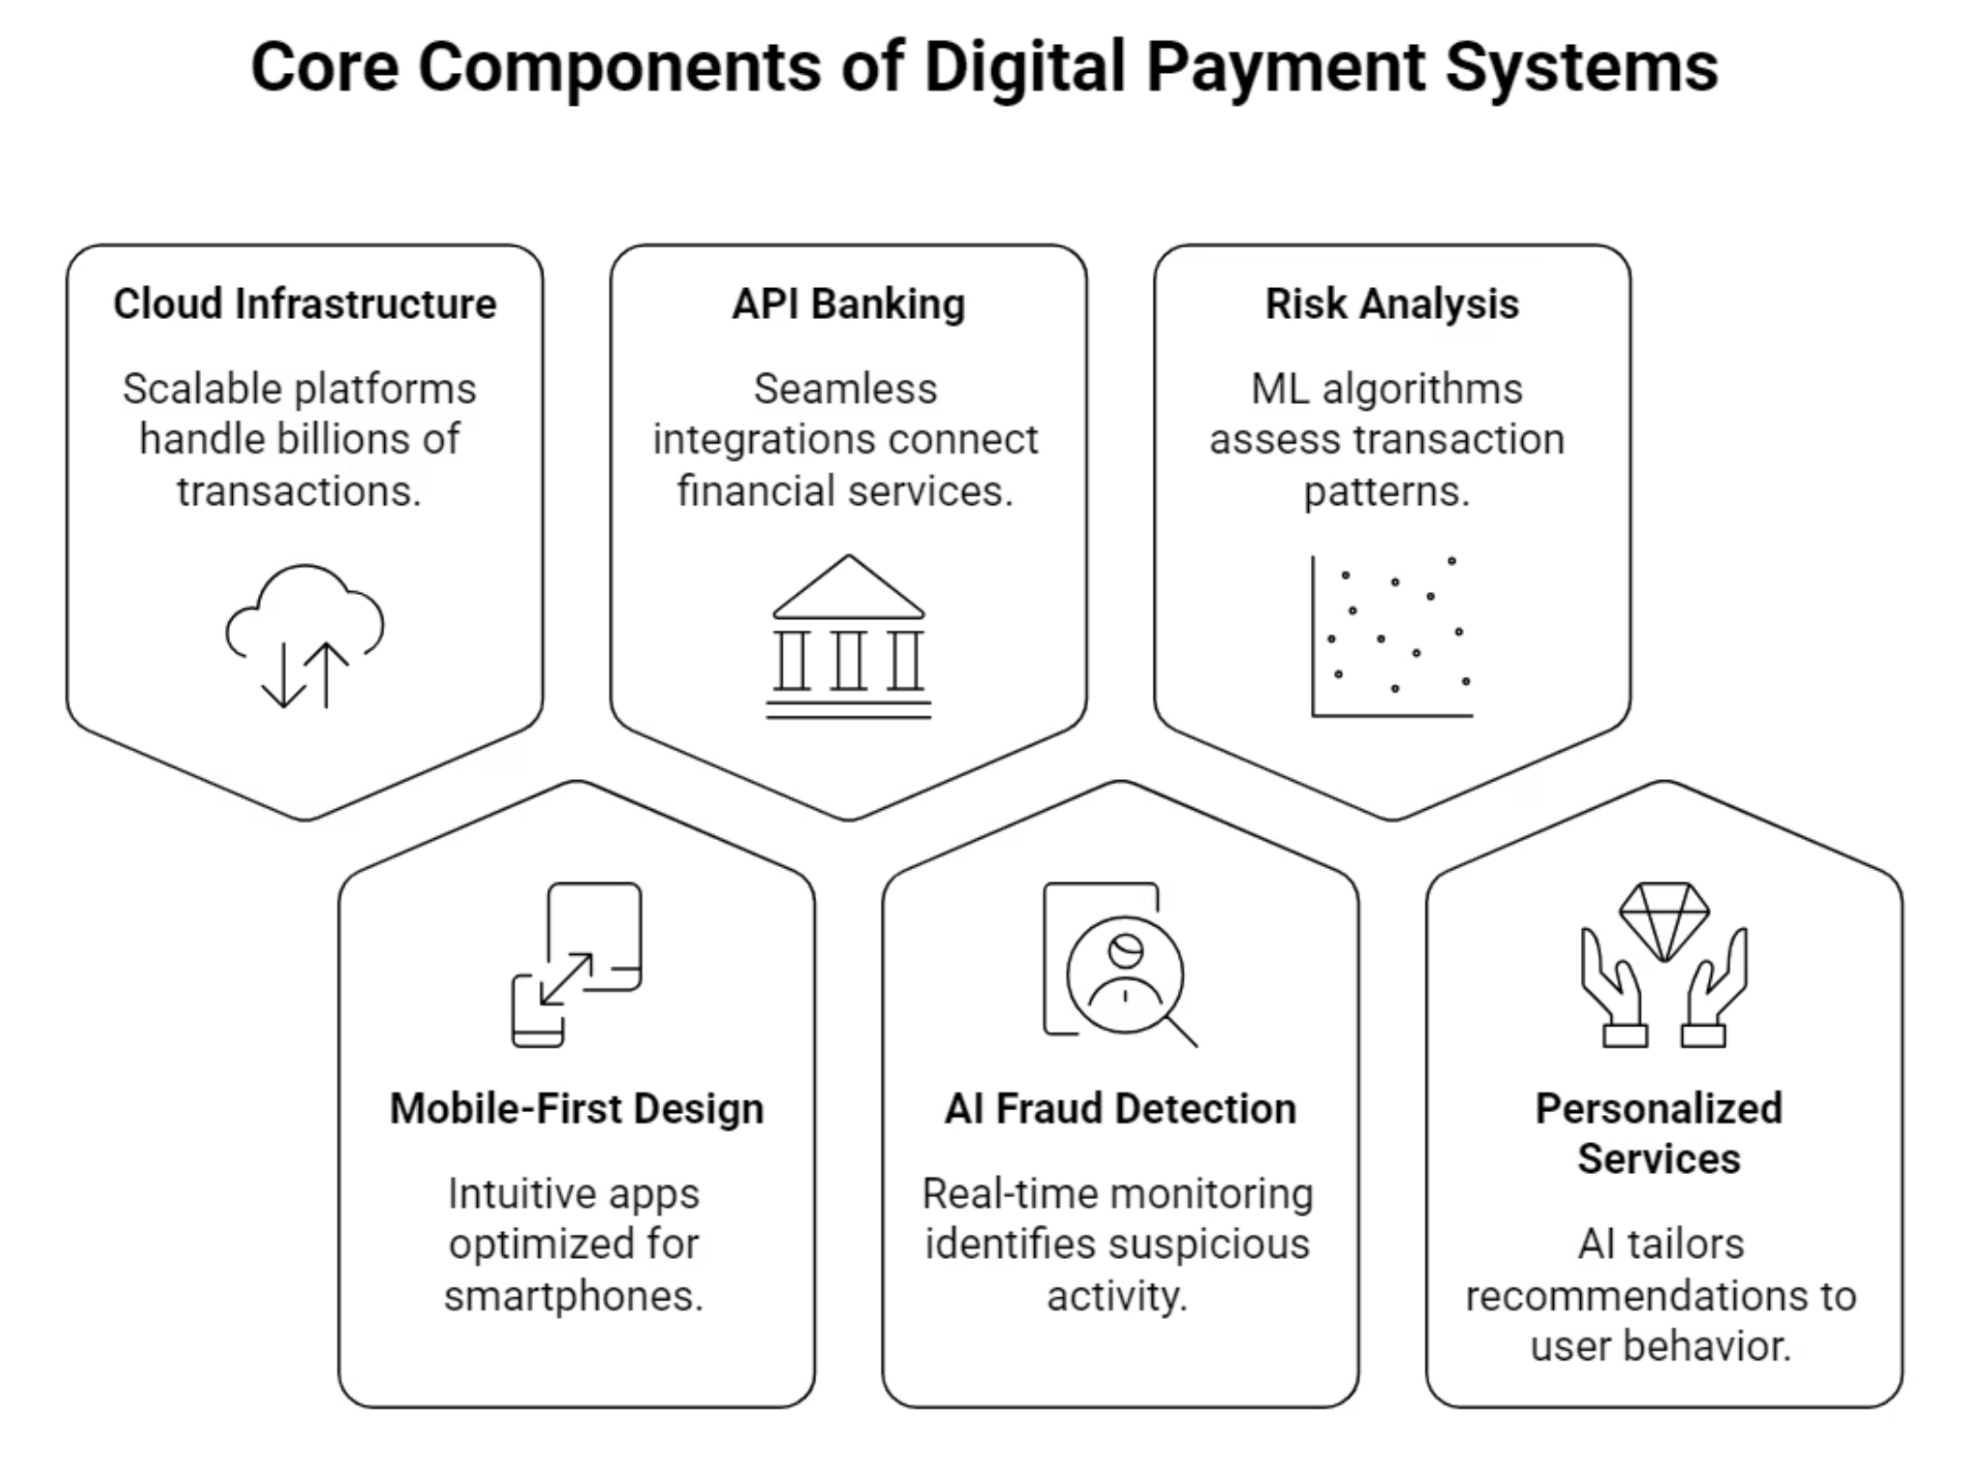
[Page 4] | Scalable infrastructure and AI drive modern payment ecosystems.

Slide 5






Role of Fintech Companies
Innovative Platforms
Financial Inclusion
Deliver seamless next-gen payment experiences.
Expand banking access to underserved populations.
Digital Lending
Investment Apps
Enable instant loan approvals through algorithmic assessment.
Democratize wealth management with AI-powered guidance.
Ecosystem Growth
Efficient Processing
Fuel startup expansion through strategic funding and partnerships.
Accelerate transactions using automated operational workflows.
[Page 5] | Driving innovation and financial inclusion in the digital landscape.

Slide 6
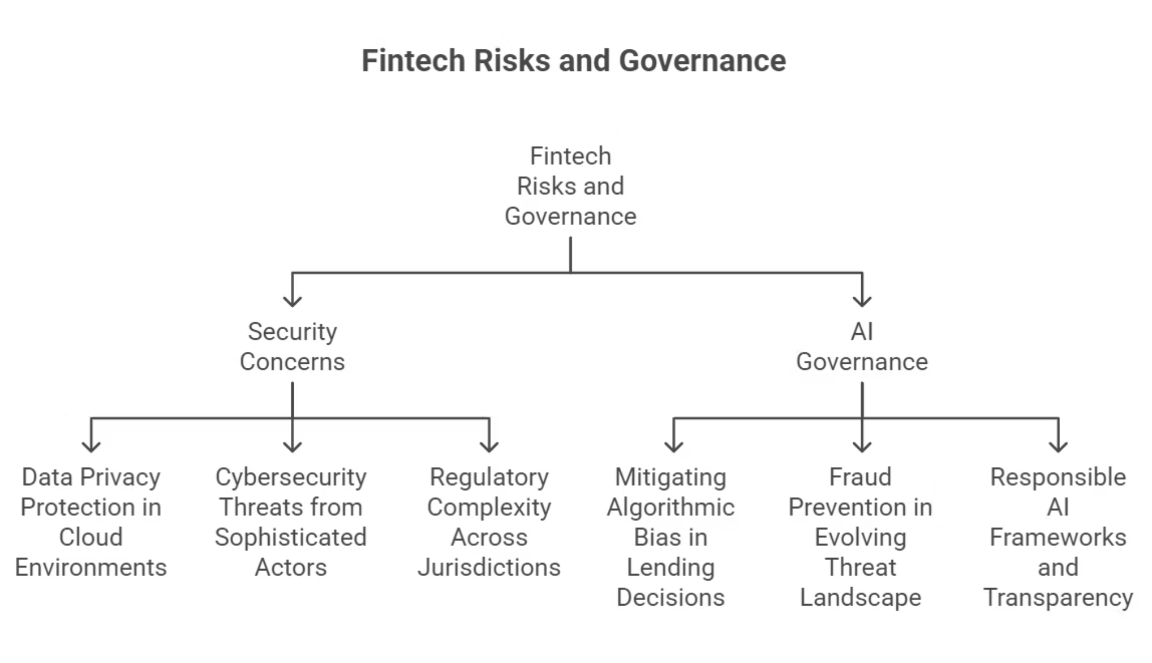
Risks and Future Challenges
[Page 6] | Navigating security, governance, and regulatory challenges in fintech scaling.

Slide 7




Proposed Solution: Scalable AI-Driven Infrastructure
Distributed Ledger Architecture
Predictive AI Scaling
Decentralize payment processing.
Anticipate demand spikes and auto-scale.
Hybrid Cloud-Edge Computing
Canary Deployment
Process transactions at the edge.
Release to 1-5% of users first, monitor, then gradual rollout.
[Page 7] | Multi-layered infrastructure approach ensures exponential growth without system failure.

Slide 8
Transaction Flow Balancing Layer and IBCB
Transaction Flow Balancing Layer
Inter-Bank Collaborative Backup (IBCB)
AI monitors real-time transaction load across banks and payment apps
Automatically routes new transactions to less congested providers
Activates load redistribution when a provider reaches ~30–40% capacity
Maintains balanced transaction flow across the payment network
Banks form collaborative network
If one bank is down, customers' transactions processed through partner bank
Money debits from original account
Processing happens via "partner bank" temporarily
Ensures zero downtime for customers
[Page 8] | Intelligent load balancing ensures system stability and reliability.

